Slide 1

Gamer Robot
Group 5
蘇冠毓 莊志淵 張原愷
Date: 2021/01/18

Slide 2

Outline
Motivation
Task – Pikaliya chess
Equipment
Methodology
Result – Demo Video

Slide 3

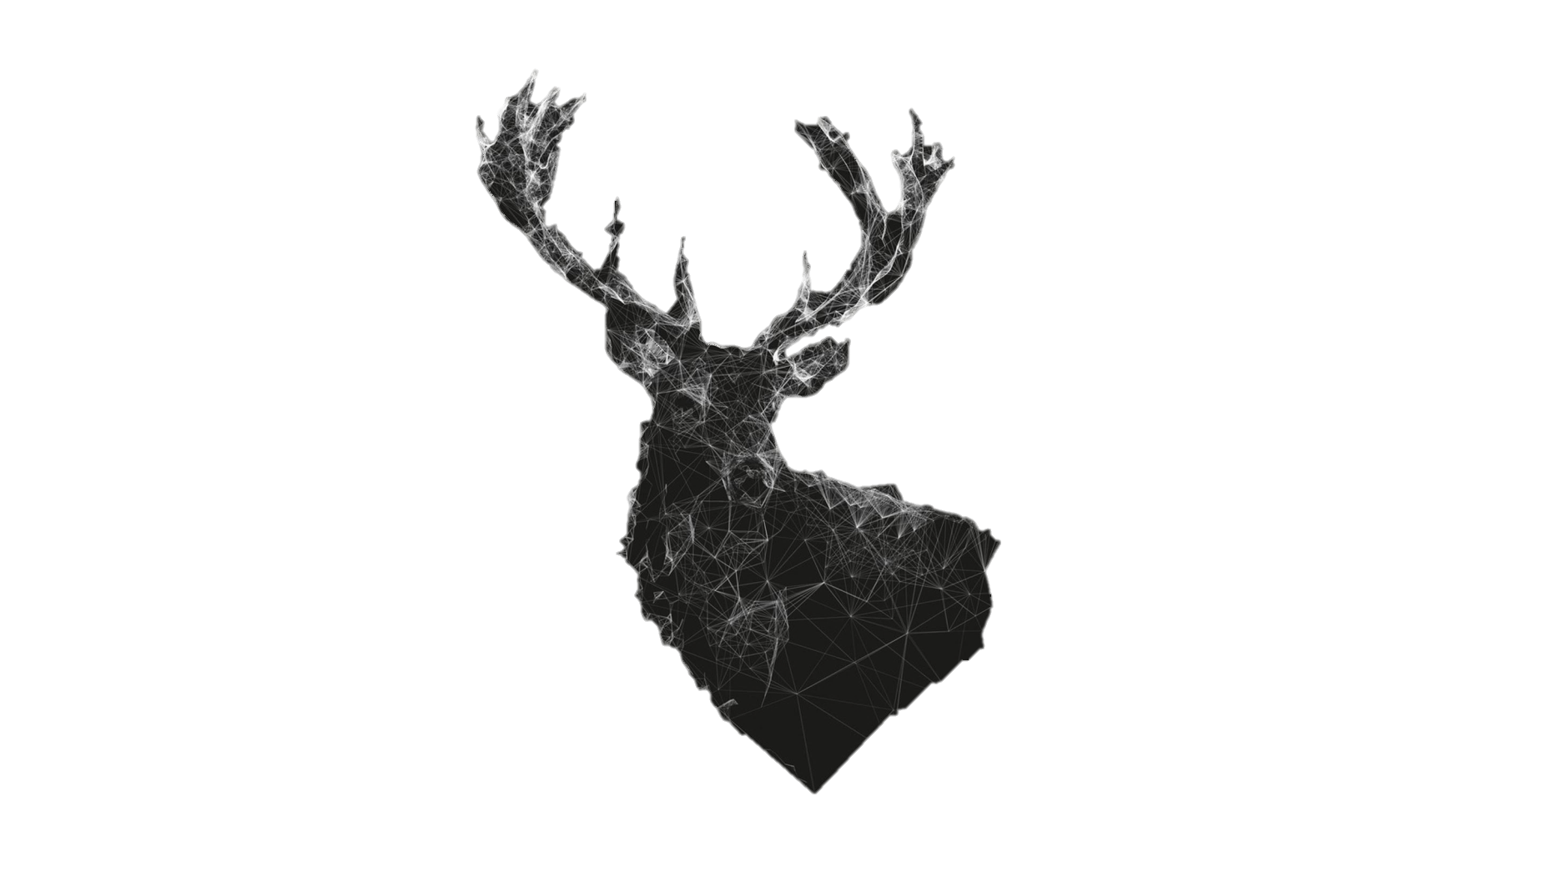
Motivation
Having no friends because of social anxiety.
Playing games without keeping social distance.
When you're alone, but you want to play some board games.

Slide 4


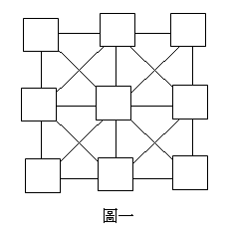
Task – Pikaliya Chess
Combine ‘Gomoku’ and ‘Tic-tac-toe’, with some modification.
Board: 3 by 3, with cross lines
Players: 2
Chess pices: Each player has 3 chess
Player A:
Player B:
Board

Slide 5
Task – Pikaliya Chess
Step 1. alternate turns placing a chess piece on an empty square.
The player who moves first can’t place the chess piece in the middle point in the first round.
Player A:
Player B:
Board

Slide 6
Task – Pikaliya Chess
Step 2. Players alternate turns moving a chess piece along any lines.
Cannot move the same chess piece as previous round!
Player A:
Player B:
Board

Slide 7
Task – Pikaliya Chess
First player to form an unbroken chain of three chess pieces horizontally, vertically, or diagonally wins.
Player A:
Player B:
Win!
Board

Slide 8


What we need
Equipment:
TM5-900 Robot Arm
RGB Webcams
Software:
OpenCV
ROS
Matlab
……..

Slide 9
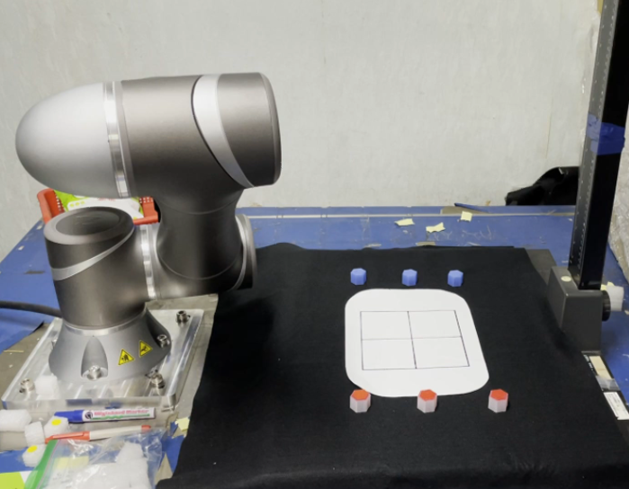
Methodology - Setup
Gamer Robot and Pikaliya chess setup.

Slide 10
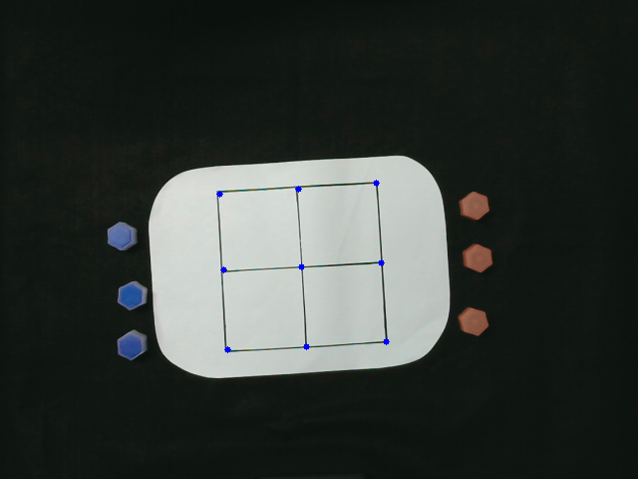
Methodology – Detection (1/2)
Sort coordinates and give a number to each chessboard corner.

Slide 11
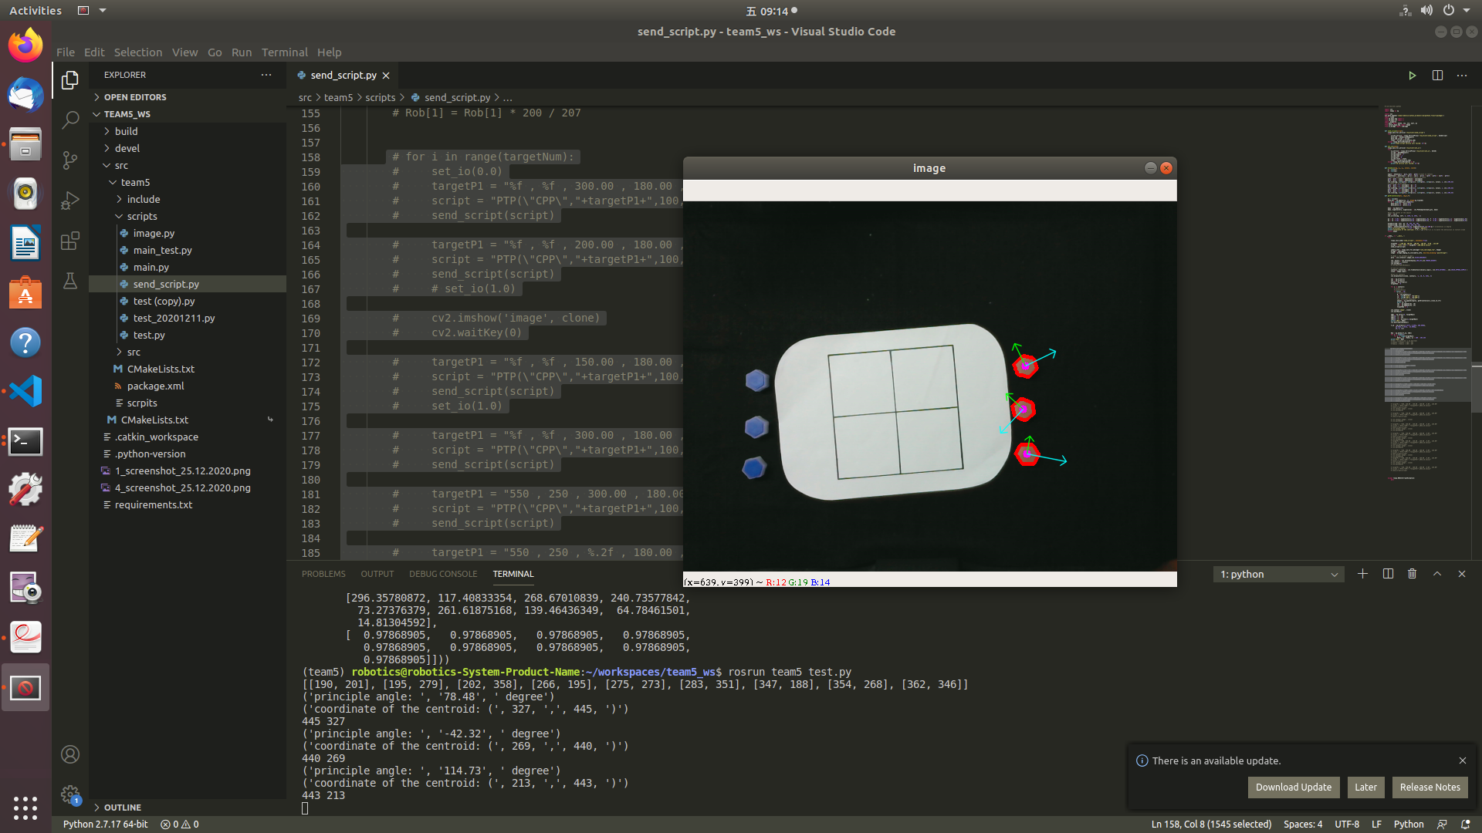
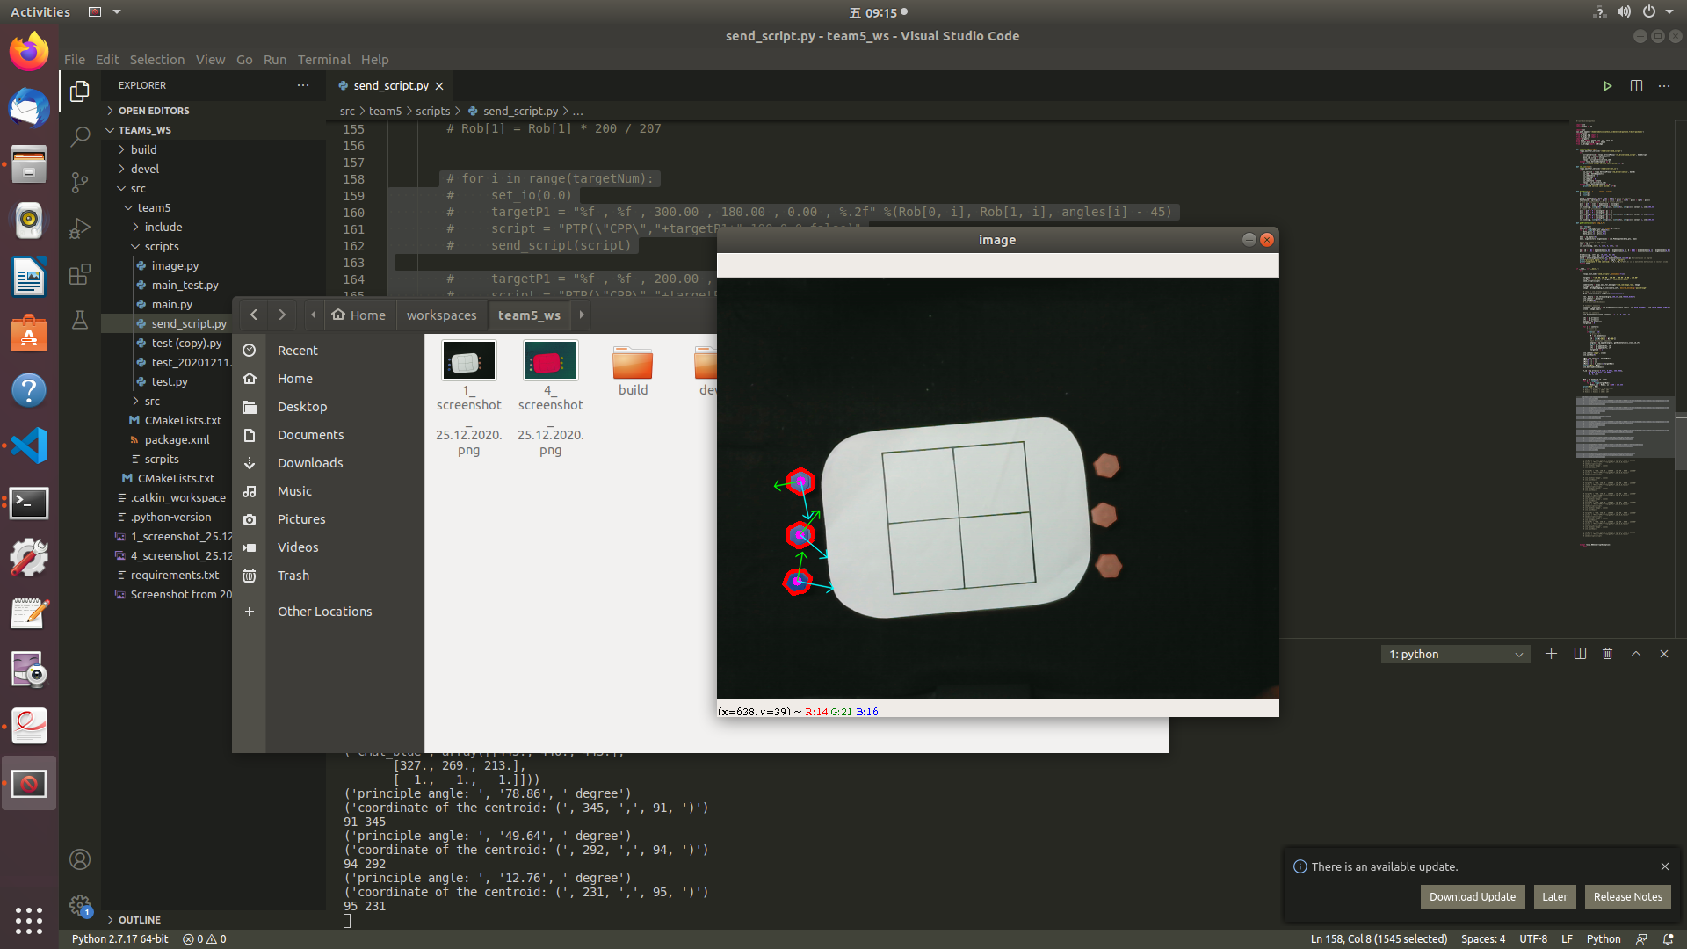
Methodology – Detection (2/2)
Distinguish between the blue and the red chess pieces.

Slide 12
Methodology – Detection (2/2)
Distinguish between the blue and the red chess pieces.

Slide 13
Methodology – Algorithm
Robot decision making
The red circles represent the player’s chess pieces and the blue ones represent the robot’s.

Slide 14
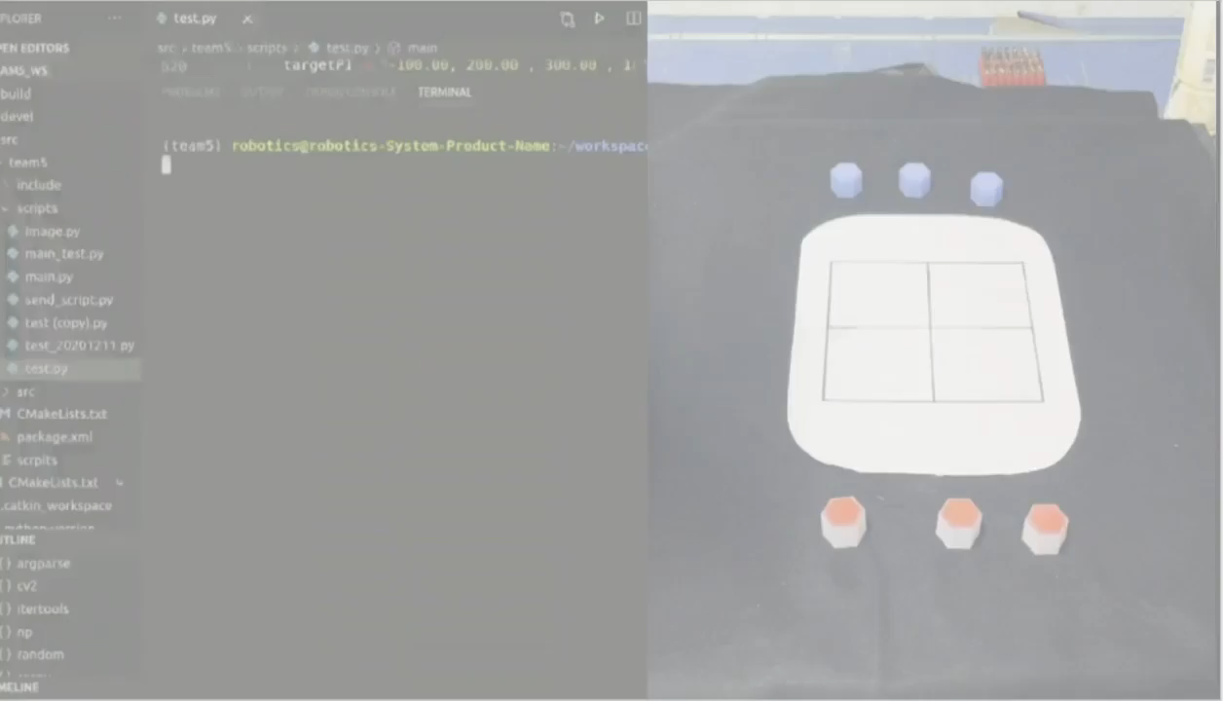
Result – Demo Video
Gamer robot playing with one of our team.
Notes:
Rule 1: Player with initiative can’t put in the middle in the first round.
Rule 2: never consecutively moves the same chess piece.

Slide 15



END
Thanks

Slide 16






